Slide 1

RETAIL BANKING TRANSACTION ANALYSIS
Findings & Business Insights
SQL-based analysis of customers, accounts, transactions, loans and branches
Presented by: E Raj Kumar

Slide 2

About Me
• B.Tech in Electronics & Communication Engineering — Institute of Aeronautical Engineering
• Why Data Science: Interested in using data and automation to reduce repetitive work and improve decision-making.
• Project Skills: SQL joins, aggregation, GROUP BY/HAVING, CASE statements, CTEs and analytical queries.
• Current Focus: Advanced SQL, database design and data analysis.
LinkedIn: linkedin.com/in/raju
GitHub: github.com/edularaj10

Slide 3
Agenda
Project Objective
1
2
Data Model & Analysis Questions
3
Key Findings & Business Insights
4
Q&A
5
Challenges & Learnings
03
INNOMATICS RESEARCH LABS

Slide 4
Objective of the Project
Core Goal: Transform relational retail banking data into actionable insights using SQL.
Operational Analysis: Understand customer segments, account ownership, branch performance and transaction behavior.
Risk Analysis: Examine active loans, payment performance, defaults and arrears.
KPI Measurement: Compare account volumes, balances, transaction counts, loan balances and payment penalties.
Technical Execution: Apply joins, GROUP BY/HAVING, CASE statements, aggregations and CTE-based SQL analysis.

Slide 5
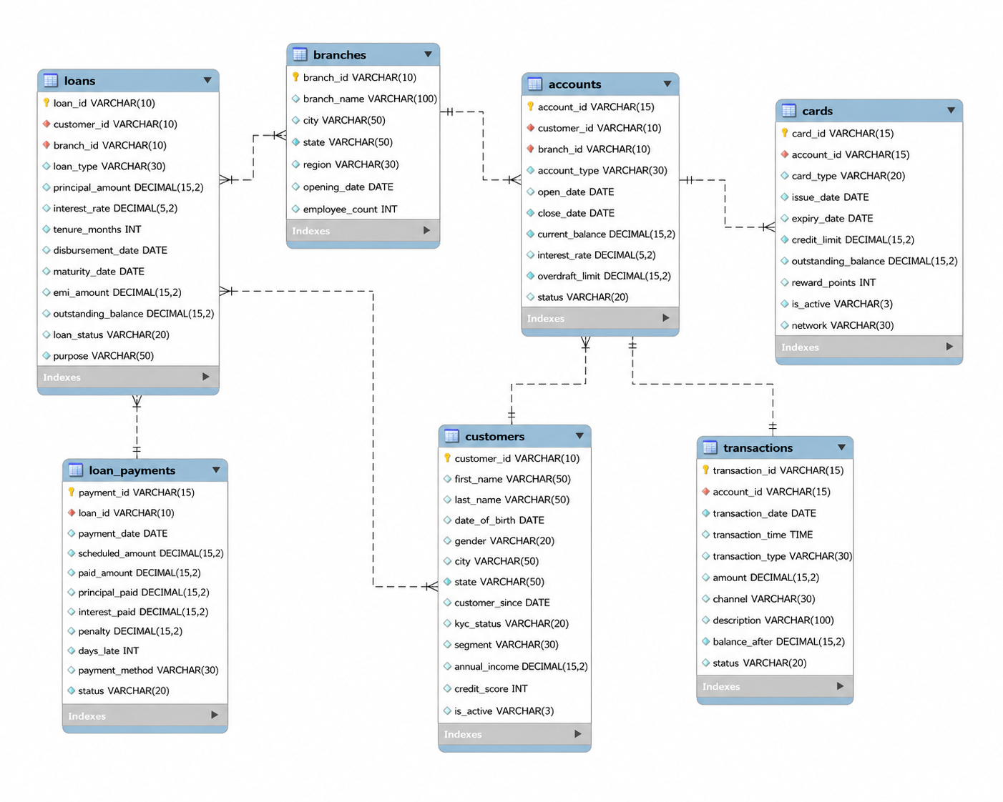
ER Diagram

Slide 6
Key Analysis Questions
Analysis Questions | SQL Technique Used
How to identify customer segments along with their demographic and income details? | SELECT + GROUP BY segment + AVG(annual_income) / COUNT(customer_id)
Which customers hold more than one bank account? | INNER JOIN (customers & accounts) + GROUP BY customer_id + HAVING COUNT(account_id) > 1
How do account volumes and total balances compare across different branches? | JOIN (branches & accounts) + GROUP BY branch_id + COUNT(account_id) / AVG(current_balance)
What are customer transaction habits across frequency, volume, and status? | JOIN (customers, accounts, transactions) + GROUP BY + SUM(amount)
Which transaction types and channels (Online, ATM, Mobile) are most common? | GROUP BY transaction_type, channel + COUNT(*) + ORDER BY DESC
Which customers have active loans, and what are their total outstanding balances? | JOIN (customers & loans) + WHERE loan_status = 'Active' + SUM(outstanding_balance)
Are customers making on-time loan payments, and what penalties are accumulated? | JOIN (loans & loan_payments) + CASE Statements + AVG(days_late) / SUM(penalty)
How does credit risk and loan performance (defaults vs. arrears) vary by branch? | JOIN (branches & loans) + Conditional Aggregation SUM(CASE WHEN loan_status...)

Slide 7
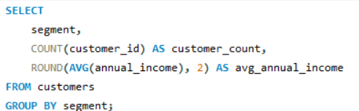
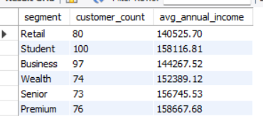
1. How to identify customer segments along with their demographic and income details?
KEY INSIGHT
• Student segment has the largest customer count (100).
• Premium segment has the highest average annual income (158,667.68).
• The results show clear differences in segment size and income.

Slide 8
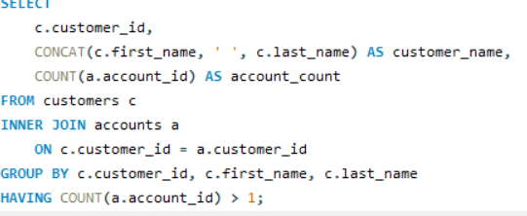
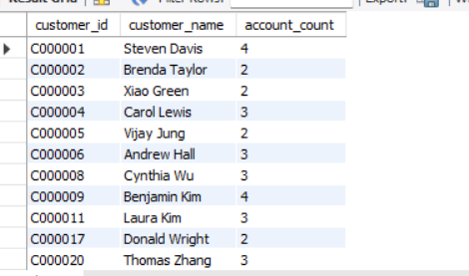
2. Which customers hold more than one bank account?
KEY INSIGHT
• The query identifies customers who hold more than one bank account.
• Several customers hold 3–4 accounts, showing multi-account ownership.
• This can support cross-selling and relationship-management strategies.

Slide 9
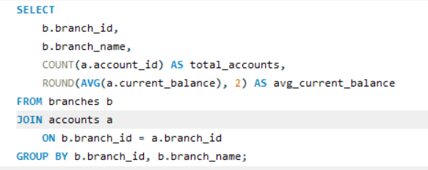
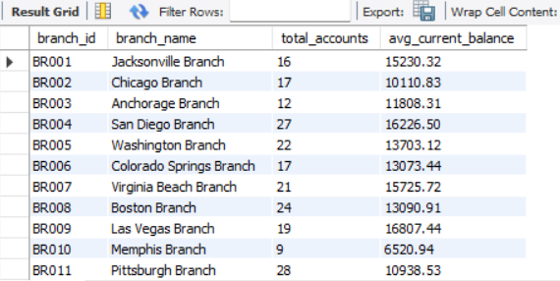
3. How do account volumes and total balances compare across different branches?
KEY INSIGHT
• Pittsburgh Branch has the highest displayed account count (28).
• Las Vegas Branch has the highest displayed average current balance (16,807.44).
• Branch performance differs in account volume versus average balance.

Slide 10
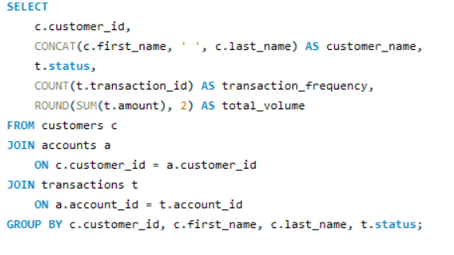
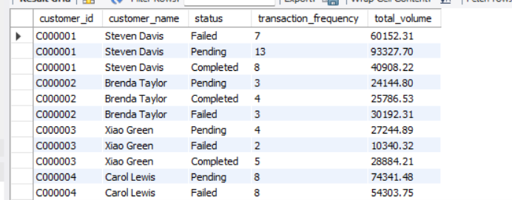
4. What are customer transaction habits across frequency, volume, and status?
KEY INSIGHT
• The query compares transaction frequency and total transaction volume by customer and status.
• Customers can show different patterns across Completed, Pending and Failed transactions.
• This helps identify high-volume customers and possible transaction issues.

Slide 11
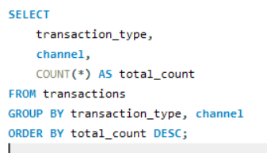
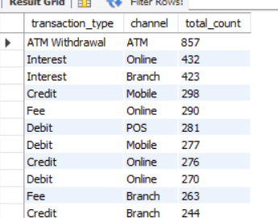
5. Which transaction types and channels (Online, ATM, Mobile) are most common?
KEY INSIGHT
• ATM Withdrawal through the ATM channel is the most frequent displayed combination (857 transactions).
• Interest through Online and Branch channels also appears frequently.
• The result helps identify the most-used transaction channels and types.

Slide 12
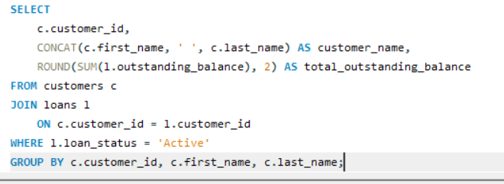
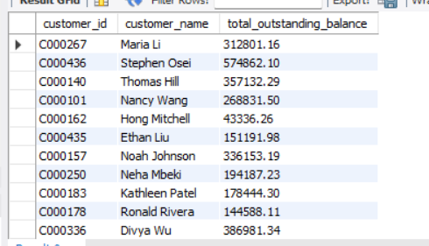
6. Which customers have active loans, and what are their total outstanding balances?
KEY INSIGHT
• The query isolates customers with Active loans and totals their outstanding balances.
• The displayed results show substantial variation in outstanding loan exposure.
• This helps prioritize customers for loan monitoring and portfolio analysis.

Slide 13
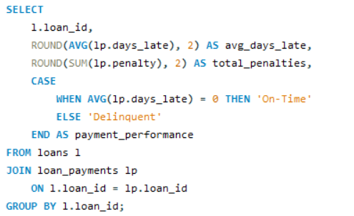
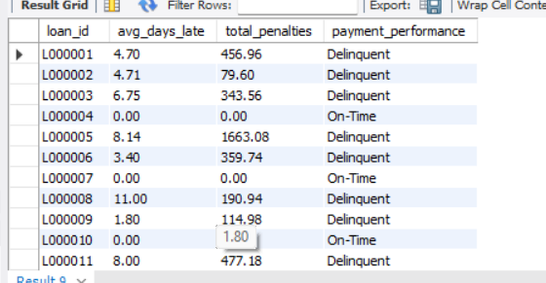
7. Are customers making on-time loan payments, and what penalties are accumulated?
KEY INSIGHT
• The results contain both On-Time and Delinquent loan payments.
• Delinquent loans show positive average days late and accumulated penalties.
• Payment timing and penalties can be used to monitor repayment risk.

Slide 14
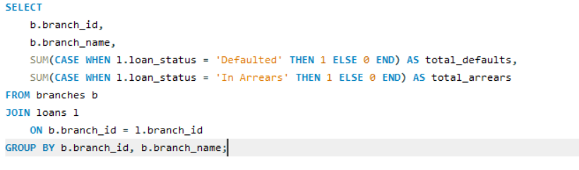
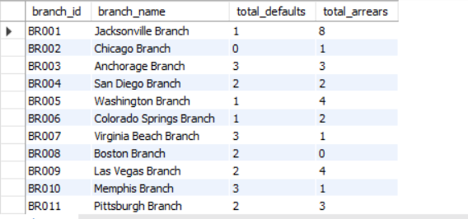
8. How does credit risk and loan performance (defaults vs. arrears) vary by branch?
KEY INSIGHT
• Jacksonville Branch has the highest displayed arrears count (8).
• Several branches show 3 defaults, indicating concentrated credit-risk pockets.
• Branch-level risk comparison helps target closer loan monitoring.

Slide 15
Your Experience / Challenges Working
Challenges Faced
Key Learnings
• Understanding relationships between multiple banking tables.
• Validating joins and avoiding duplicate results.
• Working with transaction statuses and loan-payment timing.
• Presenting technical SQL results as simple business insights.
• Designing relational SQL queries across customers, accounts, branches, transactions and loans.
• Handling multi-table joins while keeping the results accurate.
• Translating banking business questions into measurable SQL outputs.
• Using conditional aggregation, CASE statements and CTEs to make analysis clearer.

Slide 16
Key Findings & Business Insights
1. CUSTOMER SEGMENTS
Student is the largest displayed segment (100 customers), while Premium has the highest displayed average annual income (158,667.68).
2. BRANCH PERFORMANCE
Pittsburgh has the highest displayed account count (28), while Las Vegas shows the highest displayed average current balance (16,807.44).
3. TRANSACTION CHANNEL
ATM Withdrawal through the ATM channel is the most frequent displayed transaction combination, with 857 transactions.
4. LOAN RISK & PAYMENTS
The results show both on-time and delinquent payments. Jacksonville has the highest displayed arrears count (8), while several branches show 3 defaults.

Slide 17
Q&A
Questions, Discussion & Clarifications
Thank You

